Slide 1
Arrhythmia Detection on ECG Signals
in Modelling and Simulation
PREPARED BY:
Farangis Rezazadeh
Gohar Arshakyan
Kaushik Dey
Mohammadreza Shabani

Slide 2
The Team

Slide 3






The Team

Slide 4
Agenda
Problem Background
Aim
Data-Engineering Mechanisms
Estimand and Target
Methodology
Performance measurement
Conclusion

Slide 5
Problem Background

Slide 6
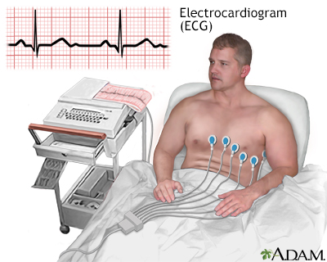
ECG Signal
An electrocardiogram (ECG) records:
these impulses to show how fast the heart is beating
the rhythm of the heart beats (steady or irregular)
the strength and timing of the electrical impulses as they move through the different parts of the heart.

Slide 7
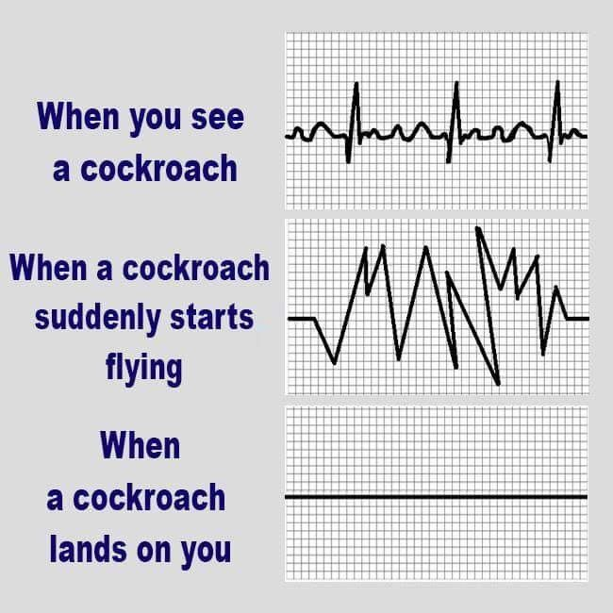


Arrhythmia
An arrhythmia, or irregular heartbeat, is:
A problem with the rate or rhythm of your heartbeat
Your heart may beat too quickly, too slowly
It is normal for your heart rate to speed up during physical activity and to slow down while resting or sleeping.

Slide 8

Arrhythmia Consequences
An arrhythmia can lead to:
Damage the heart, brain, or other organs.
A life-threatening stroke, heart failure, or cardiac arrest can all be deadly.

Slide 9
Aim

Slide 10

Aim
Arrhythmia detection from ECG signals
ADEMP framework adapted to simulation studies
To be sure that we have a reliable result (F1 score) obtained from the first run

Slide 11
Data-Engineering Mechanisms

Slide 12



Data Description
The MIT-BIH Arrhythmia Database
48 half-hour excerpts of two-channel ambulatory ECG recordings, obtained from 47 subjects (patients)
BIH Arrhythmia Laboratory between 1975 and 1979.
Electrocardiogram (ECG) shapes of heartbeats
Normal case and different type of arrhythmias
Numeric & CSV format
188 features & 87554 rows
Imbalance data

Slide 13
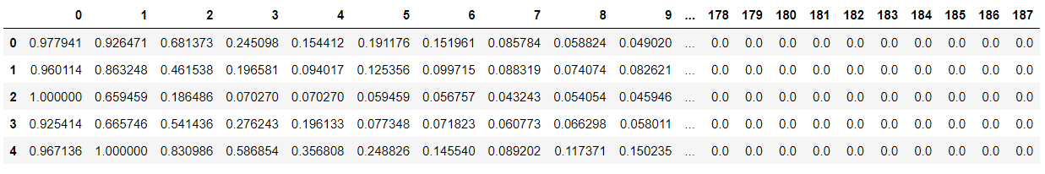
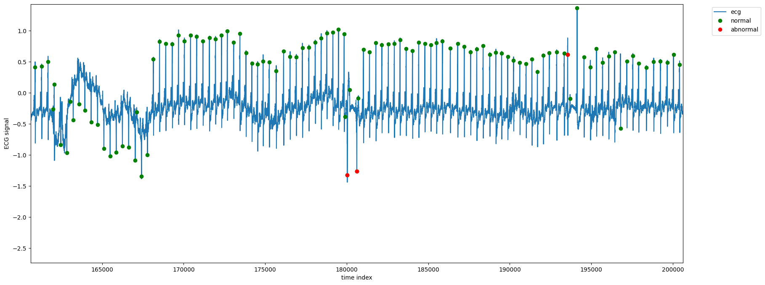
Pre-processing

Slide 14






Pre-processing
Adding Gaussian Noise
Train-test split
Normal 0
&
Arrythmia 1 2 3 4

Slide 15

Bootstrapping
Resampling bootstrap technique
100 simulations two times
Precision, Recall, F1 score

Slide 16
Estimand and Target

Slide 17
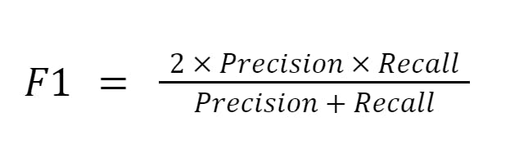
Estimand and Target
Imbalanced Data

Slide 18
Methodology

Slide 19
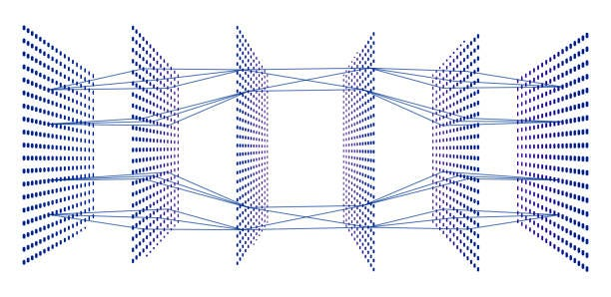
CNN

Slide 20
Convolutional Neural Network (CNN) - Architecture
Layer Type | Output Shape | Number of Parameters | Activation Function
Input | (features, 1) | 0 | None
Convolutional | (features, 64) | 448 | ReLU
Max Pooling | (features/2, 64) | 0 | None
Convolutional | (features/2, 64) | 12,352 | ReLU
Max Pooling | (features/4, 64) | 0 | None
Convolutional | (features/4, 64) | 12,352 | ReLU
Max Pooling | (features/8, 64) | 0 | None
Flatten | (features/8 * 64) | 0 | None
Dense | 64 | 32,896 | ReLU
Dense | 32 | 2,080 | ReLU
Output | 1 | 33 | Sigmoid

Slide 21
CNN Results
Results | 1st run | 2nd run
Original Model F1 Score | 0.78 | 0.75
Average F1 Score (20 Sim.) | 0.75 | 0.79
F1 Confidence Interval | [0.60, 0.86] | [0.67, 0.86]
Simulation Time | 1.45 hrs | 1.45 hrs

Slide 22

DNN

Slide 23
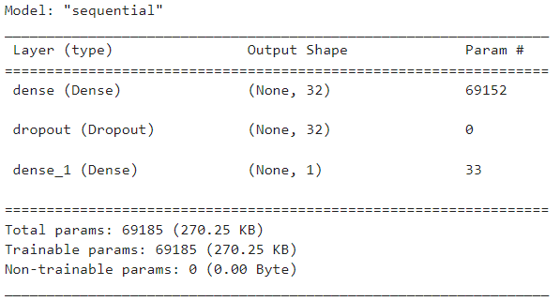
Dense Neural Network (DNN)
Results (1st and 2nd run)
Original Model F1 Score | 0.95
Average F1 Score (100 Sim.) | 0.96
F1 Confidence Interval | [0.95, 0.97]
Simulation Time | 1:30 hrs

Slide 24

Random Forest

Slide 25
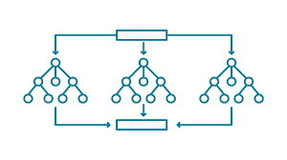
Random Forest
Results | 1st run | 2nd run
Original Model F1 Score | 0.98 | 0.97
Average F1 Score (100 Sim.) | 0.97 | 0.97
F1 Confidence Interval | [0.9782, 0.9787] | [0.9778, 0.9783]
Simulation Time | 2:30 hrs | 2.30 hrs

Slide 26
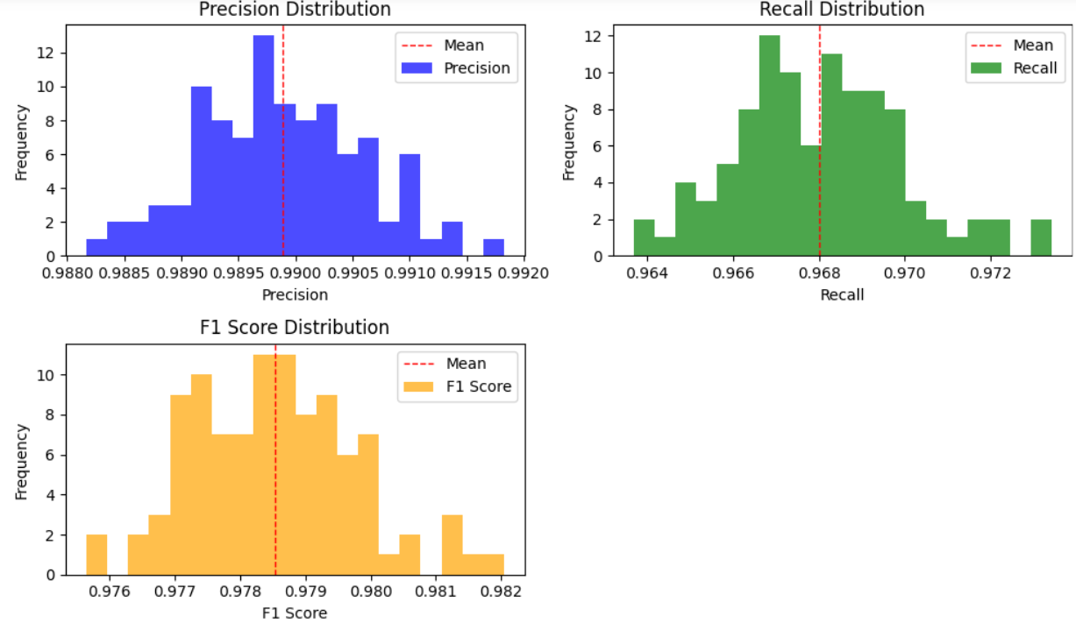
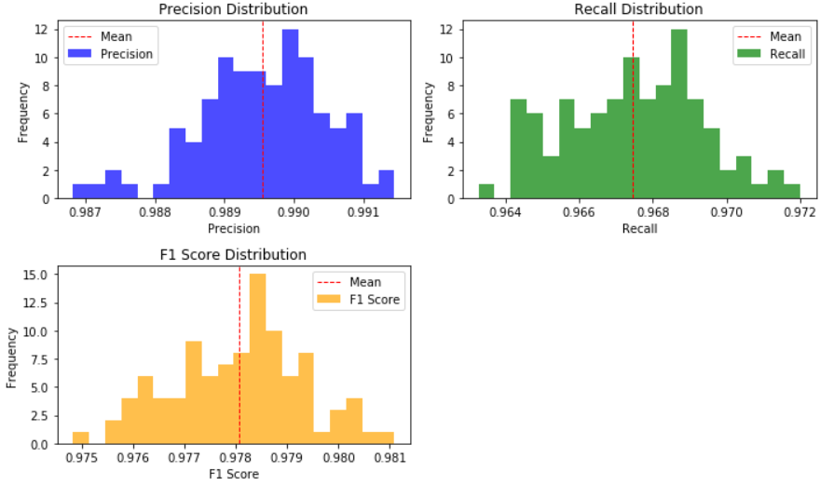
Random Forest
First 100 simulation
Second100 simulation

Slide 27
Performance Measurement

Slide 28
Performance measurement
Models | CNN | DNN | Random Forest
Original Model F1 Score | 0.75 | 0.95 | 0.98
Average F1 Score | 0.79 | 0.96 | 0.97
Confidence Interval for F1 Scores | [0.67, 0.86] | [0.95, 0.97] | [0.9782, 0.9787]
Simulation Time | 1.45 hrs | 1:30 hrs | 2:30 hrs

Slide 29
Conclusions

Slide 30
Conclusions
We focused on arrhythmia detection using ECG signals with the ADEMP framework adapted to simulation studies.
Timely and accurate detection of irregular heartbeats is crucial.
Leveraging the MIT-BIH Arrhythmia Database, we analyzed electrocardiogram shapes, including normal cases and various arrhythmias.
Despite challenges like imbalanced data, our findings demonstrated reliable results:
CNN achieved an average F1 score of 0.79 in 1.45 hours.
DNN surpassed expectations with an F1 score of 0.96 in 1.30 hours.
Random Forest delivered exceptional results with an F1 score of 0.97 in 2.30 hours.

Slide 31


